Slide 1

Spark and Python
With VirtualBox
Let’s learn something!

Slide 2
Python and Spark
This lecture will walk through how to download and set-up VirtualBox with Ubuntu.
Then we will walk through installing Spark,Python, and the Jupyter Notebook on this VirtualBox Unbtunu.

Slide 3
Python and Spark
The resources for this lecture has a link to a written form of these instructions that you can reference.

Slide 4
Python and Spark
First you will need to download:
VirtualBox
Ubuntu
Let’s show you how you can find these.

Slide 5
Spark and Python
With VirtualBox Part 2
Let’s learn something!

Slide 6
Python and Spark
In Part 2 we will install Python,Spark,and the Jupyter Notebook onto our Ubuntu Machine.
If Ubuntu was already your local OS, you skipped Part 1 and came here!

Slide 7
Python and Spark
A quick note:
Spark 2.1 is incompatible with Python 3.6
This will be fixed when Spark 2.2 is released, in the meantime, we’ll stick to Python 3.5 to avoid issues!

Slide 8
DataBricks Setup
Let’s learn something!

Slide 9
Python and Spark
Databricks is a company that provides clusters that run on top of AWS and adds a convience of having a Notebook System already set up and the ability to quickly add files.

Slide 10
Python and Spark
It has a free community version that supports a 6 GB cluster.
It also has its own storage format known as DBFS.
This “Table” format needs to be accessed in a particular way.

Slide 11
Python and Spark
We’re going to walk through how to setup a Databricks account and how you can upload data and set it as a DataFrame.
I recommend Databricks for people who want to quickest online setup.

Slide 12
Python and Spark
Go to:
https://databricks.com/try-databricks

Slide 13
AWS EMR Setup
Let’s learn something!

Slide 14
Python and Spark
If you want to quickly set up a cluster with a Notebook Interface, AWS EMR is a good choice.
Please note, what we will show in this lecture does not fall under the free trial of AWS.

Slide 15
Python and Spark
In this lecture we will will walk through setting up the Zeppelin Notebook.
We will also discuss some security options, I highly recommended you watch the EC2 Instance Lectures first before watching this to learn about SSH!

Slide 16
Python and Spark
The Zeppelin Notebook is a fairly new environment that mimics Jupyter Notebook’s capabilities but was created specifically with Big Data (Spark, Hadoop, etc…) in mind.

Slide 17
Python and Spark
Let’s quickly explore what the Zeppelin Notebook looks like on their official docs and then go through the process of setting up our own on AWS EMR.
Creating the cluster on AWS EMR can take awhile to intialize!

Slide 18
Python and Spark
We’ll also talk about security settings as we set-up the Zeppelin Notebook running on EMR, make sure to read through the resource documentation to choose the best security settings for you or your organization!

Slide 19
Python and Spark
Let’s get started and jump into the docs:
zeppelin.apache.org
Afterwards we will log into to our AWS:
aws.amazon.com

Slide 20
Spark and Python on AWS EC2

Slide 21
Python and Spark
This lecture will walk through how to set-up Python, Spark, and a Jupyter Notebook on AWS EC2
Before we begin let’s discuss a few things to keep in mind!

Slide 22
Python and Spark
This is by far the most tedious set-up option out of the four.
While everything we will show is within the free (one-year) tier for AWS, you still need a credit card to set up an account.

Slide 23
Python and Spark
If you create an EC2 instance using different parameters than what is shown here, you may be liable for charges!
Make sure to follow the directions shown in this video exactly, otherwise you will have to repeat the process all over again.

Slide 24
Python and Spark
Leave yourself plenty of time to go through this process.
If you feel uncomfortable with any of this, just go to the VirtualBox installation lectures, those are local, simpler, and 100% free!

Slide 25
Python and Spark
Overall, this EC2 process is not too bad, but keep in mind that if you get an error during this process, it is because you made a mistake somewhere not following with the video lectures!
Let’s get started walking you through the process of setting up!

Slide 26
AWS Account Set-Up

Slide 27
Go to:
https://aws.amazon.com/free
Then click on Create Free Account
Sign up with an email address
Then fill out the profile information

Slide 28
The profile information:
Contact Information
Billing Information
ID Verification
Choose free support plan
Next lecture we will explore AWS and create an EC2 instance

Slide 29
EC2 Instance Set-up

Slide 30
Now that we have our AWS account we will create an EC2 Instance.
Amazon Elastic Compute Cloud (Amazon EC2) is a web service that provides resizable compute capacity in the cloud.
We can basically think of it as a virtual computer we can access through the internet.

Slide 31
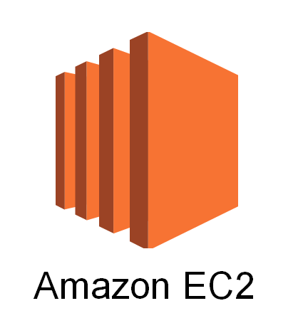


So here is our plan:
Create EC2 Instance on AWS
Use SSH to connect to EC2 over internet
SSH is different for Windows vs Mac/Linux
Set-up Spark and Juptyer on EC2 Instance
SSH
Local

Slide 32
SSH (Secure Shell Connection)
Watch this lecture all the way through for Windows
Skip to next lecture after EC2 Set-up for Mac/Linux
Our goal is to remotely connect to the command line of our virtual machine on Amazon EC2

Slide 33
Login to your AWS console at:
aws.amazon.com

Slide 34
PySpark Set-up

Slide 35
SSH with Mac and Linux

Slide 36
Skip this lecture if you are on Windows, you should have connected to your instance already from the previous lecture
We’ve created our EC2 instance using AWS console
You should have also downloaded the .pem file
Now we are going to connect to our instance through our terminal using SSH

Slide 37
Make sure you can locate your .pem file
Recommend you relocate it to your Desktop
Make sure you have the DNS address of your EC2 instance
Check the resource link for the step by step instructions from Amazon
Let’s get started by opening our terminal

Slide 38
Installations on EC2

Slide 39
Python and Spark
By now you should have been able to SSH into your EC2 instance (PuTTY for Windows, directly for Mac/Linux)
Everything we’ll do now will be directly through this command line interface.
Make sure to follow along carefully!

Slide 40
Python and Spark
Our tasks for this EC2 instance:
Download and Install Spark
Install Jupyter Notebook
Connect with PySpark
Access EC2 Juptyer Notebook in our local browser!

